Slide 1
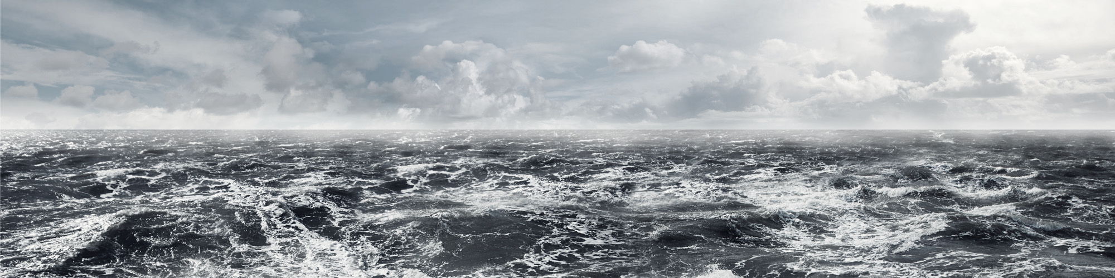
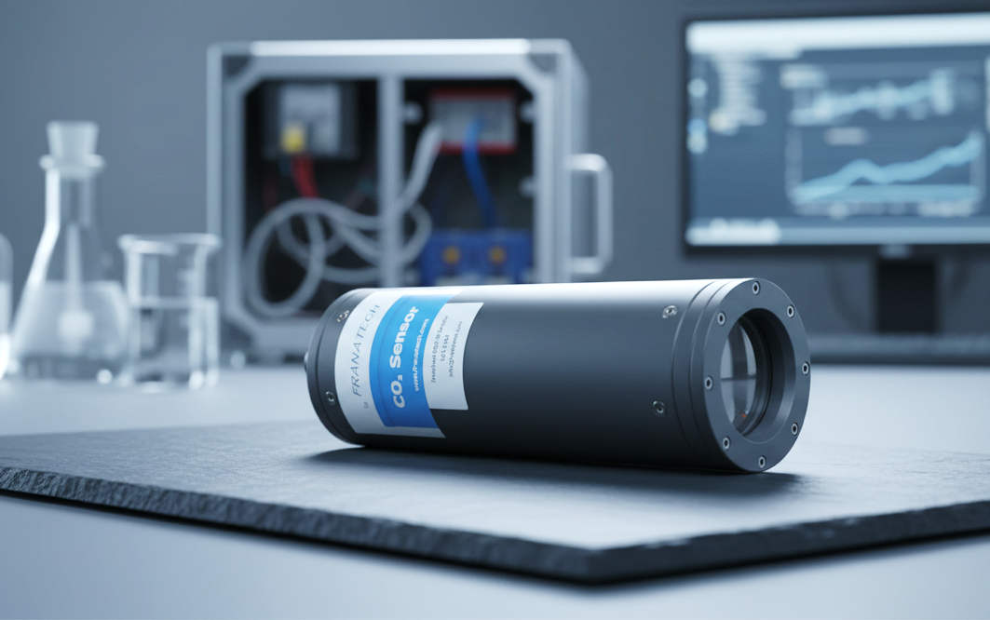
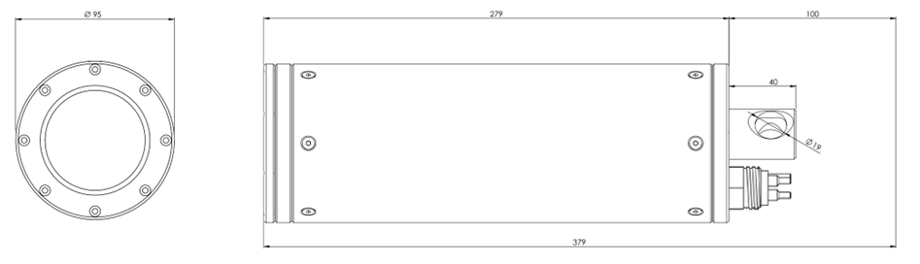

THE precision HR-SENSOR
for dissolved co2
AQUACULTURE for reliable process control
HYDROELECTRICITY for long-term monitoring of reservoirs
COASTAL for the survey of water quality
Features
PRODUCT DATA
Plug-and-play
Easy to use
Continuous monitoring
Reliable and accurate
Maintenance limited to a few minutes a month
Recalibration every 3 to 5 years.
Depth sensor up to 300m
Range 1 - 50 mg/l
Operation temperature -2°C - +40°C
Salinity 0.5 – 40.0 ‰
Output analog 4..20mA
Supply voltage nominal 24 VDC
Power consumption <2.0 W
Sensor 2.6 kg
Cable MCIL8F standard 10m
Part number Franatech 106381
The FRANATECH CO₂-HR is an in-situ sensor to be deployed underwater. It measures the Carbon Dioxide dissolved in fresh or salt water. The concentration of dissolved CO₂ in the water equilibrates with the concentration in the internal detector room of the sensor. Outside water and detector room are separated by a pressure resistant membrane inlet system, which is impermeable to water and ions, but let gases diffuse freely back and forth. The process is continuous and reversible, so that the changes of internal concentration are mirroring the changes in the outside water. The internal detector uses Infra-Red Absorptiometry to analyse the gas. This technology is tuned for CO₂, thus minimizing cross-sensitivities.
DIMENSIONS
(in mm)
Ø 95
279
100
40
Ø 19
379
Franatech GmbH www.franatech.com Info@franatech.com
WE GO THE WAY WITH YOU.
ENVIRONMENTAL MONITORING GAS LEAK DETECTION OIL LEAK DETECTION

