Slide 1

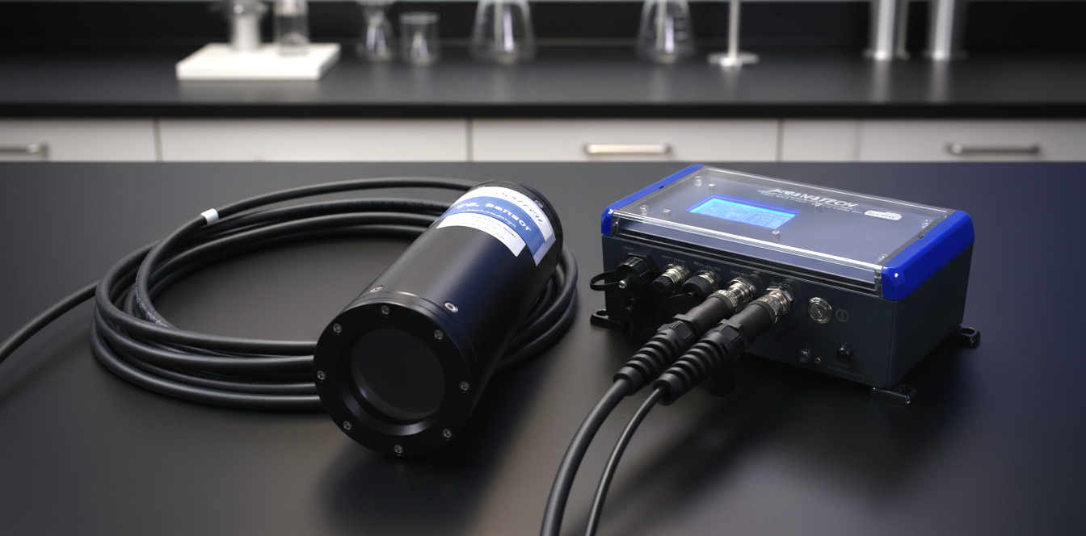

THE CO₂ HR-SENSOR SET
_{Sensor – CABle – DATALOGGER}
AQUACULTURE for reliable process control
HYDROELECTRICITY for long-term monitoring of reservoirs
COASTAL for the survey of water quality
The FRANATECH CO₂ HR sensor set is a stand-alone CO2 measuring device which enables the user for online monitoring and datalogging in a standard data format. The sensor measures the Carbon Dioxide dissolved in fresh or salt water. The concentration of dissolved CO₂ in the water equilibrates with the concentration in the internal detector room of the sensor. Outside water and detector room are separated by a pressure resistant membrane inlet system, which is impermeable to water and ions, but let gases diffuse freely back and forth. The process is continuous and reversible, so that the changes of internal concentration are mirroring the changes in the outside water. The internal detector uses Infra-Red Absorptiometry to analyse the gas. This technology is tuned for CO₂, thus minimizing cross-sensitivities.
PRODUCT DATA
SENSOR
Depth up to 300m
Range 1 - 50 mg/l
Operation temperature -2°C - +40°C
Salinity 0.5 – 40.0 ‰
Sensor 2.6 kg
Part number Franatech 106381
STANDARD CABLE MCIL4F (10m)
Part number Franatech 103006
DATALOGGER
Power supply 24 V DC (9–30 V) or 110–240 V AC
Power consumption ~6 W
Outputs RS485, 3 × 4–20 mA (CO₂ ppmv, CO₂ mg/l, temperature)
Data storage Internal MicroSD (FAT32)
Protection class IP66
Operation temperature −2 °C to +40 °C
Interfaces Front display, USB
Part number Franatech 103763
Features
Continuous monitoring
Integrated display for live measurement, values and status
Internal data logger with MicroSD card storage
USB interface for configuration and data download
Configurable logging interval
Automatic restart and data integrity after power interruption
Robust enclosures for harsh environments
Maintenance limited to a few minutes a month
Recalibration every 3 to 5 years
Franatech GmbH www.franatech.com Info@franatech.com
WE GO THE WAY WITH YOU.
ENVIRONMENTAL MONITORING GAS LEAK DETECTION OIL LEAK DETECTION

